Slide 1
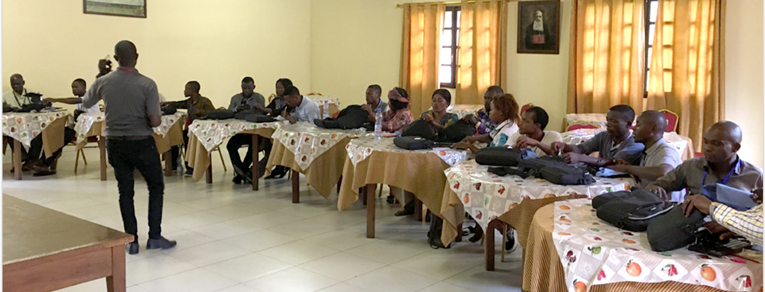
Plans go wrong where there is no advice, but with numerous advisors they succeed (Prov. 15:22).
All Scripture taken from the English Unlocked Literal Bible (ULB), ©2017, 2022 Wycliffe Associates, Available at https://bibleineverylanguage.org/translations, licensed under the Creative Commons Attribution-ShareAlike 4.0 International License.
The English ULB is based on the unfoldingWord® Literal Text, CC BY-SA 4.0. The original work of the unfoldingWord® Literal Text is available at https://unfoldingword.bible/ult/.
Workshop Planning

Slide 2
Ephesians 6:19-20
And pray for me, that a message might be given to me when I open my mouth. Pray that I might make known with boldness the hidden truth about the gospel. It is for the gospel that I am an ambassador who is kept in chains, so that I may declare it boldly, as I ought to speak.

Slide 3
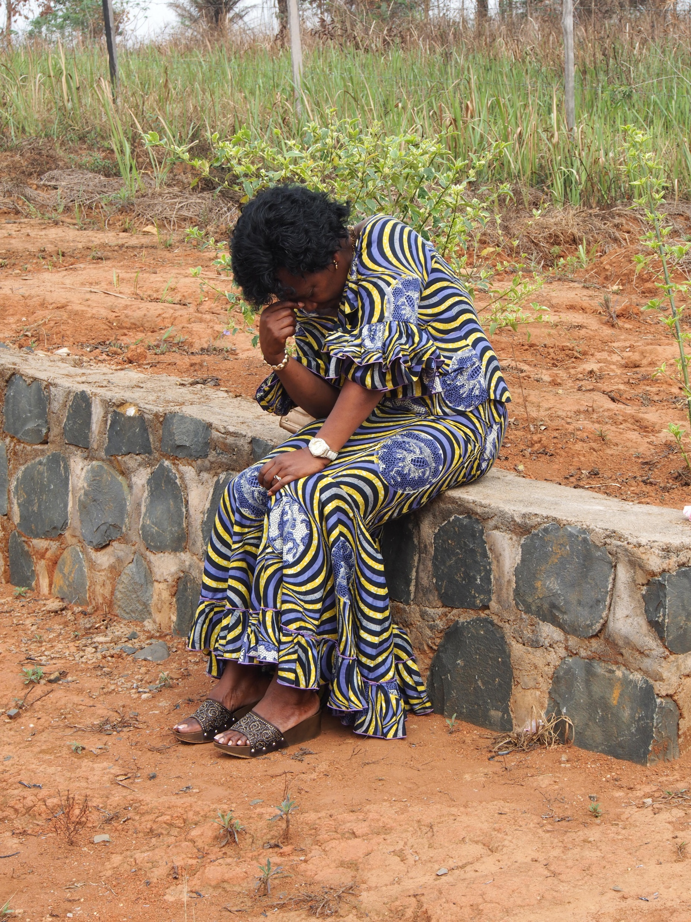
Prayer
Wisdom
Discernment
Accuracy
Unity
Good communication
Safety
Protection
Health
Engaging in Spiritual warfare

Slide 4

Inspirational Devotions
Matthew 28:19
Genesis 11
God created languages
Teaching to observe all things
Revelation 5
Romans 12
All languages will worship Him
One body, different skills
Include translated verses each day

Slide 5
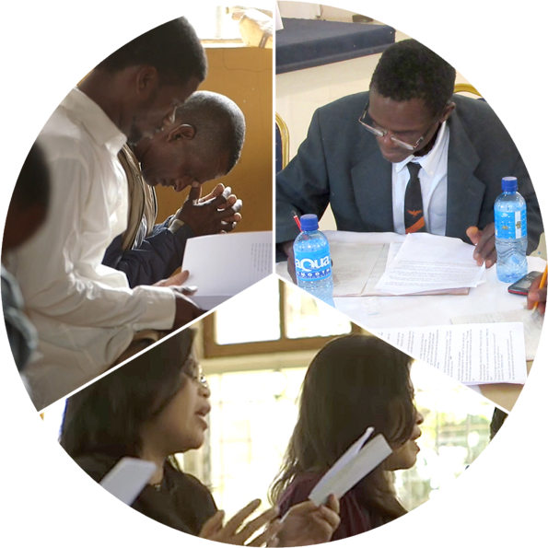
Meeting the Needs of Translators
Physical and spiritual/ interpersonal needs
Translators must function at the highest level of thought

Slide 6


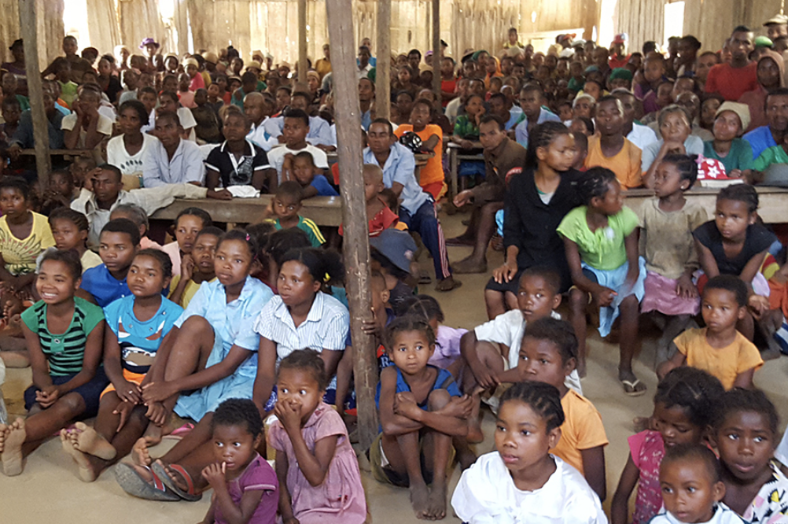





Hierarchy of Need (based on Maslow’s)
Focus on Ministry
Esteem
Needs
Love and Belonging
Needs
SafetyNeeds
Physical
Needs

Slide 7
James 2:15 –16
Suppose that a brother or sister is badly clothed and lacks food for the day. Suppose that one of you says to them, "Go in peace, stay warm and be filled." If you do not give them the things necessary for the body, what profit is that?

Slide 8
Values-Based Learning Instructors/Facilitators must show: Honesty Common Interest Praise Protection Service

Slide 9

Honesty
Therefore, get rid of lies, and let each one of you speak truth with his neighbor, because we are members of one another (Ephesians 4:25).

Slide 10

Common Interest
If there is any encouragement in Christ, if there is any comfort provided by love, if there is any fellowship in the Spirit, if there are any tender mercies and compassions, then make my joy full by being of the same mind, having the same love, being united in spirit, and having one purpose (Philippians 2:1-2).

Slide 11

Praise
Therefore comfort one another and build each other up, just as you are already doing (1Thessalonians 5:11).

Slide 12

Protection
In all things I gave you an example of how you should help the weak by laboring, and of how you should remember the words of the Lord Jesus, words that he himself said: 'It is more blessed to give than to receive’ (Acts 20:35).

Slide 13

Service
But it must not be this way among you. Instead, whoever wishes to become great among you must be your servant, ²⁷ and whoever wishes to be first among you must be your servant, ²⁸ just as the Son of Man did not come to be served, but to serve, and to give his life as a ransom for many (Matthew 20:26-28).

Slide 14
?
How has feeling valued helped you?
How have you expressed value to others?

Slide 15
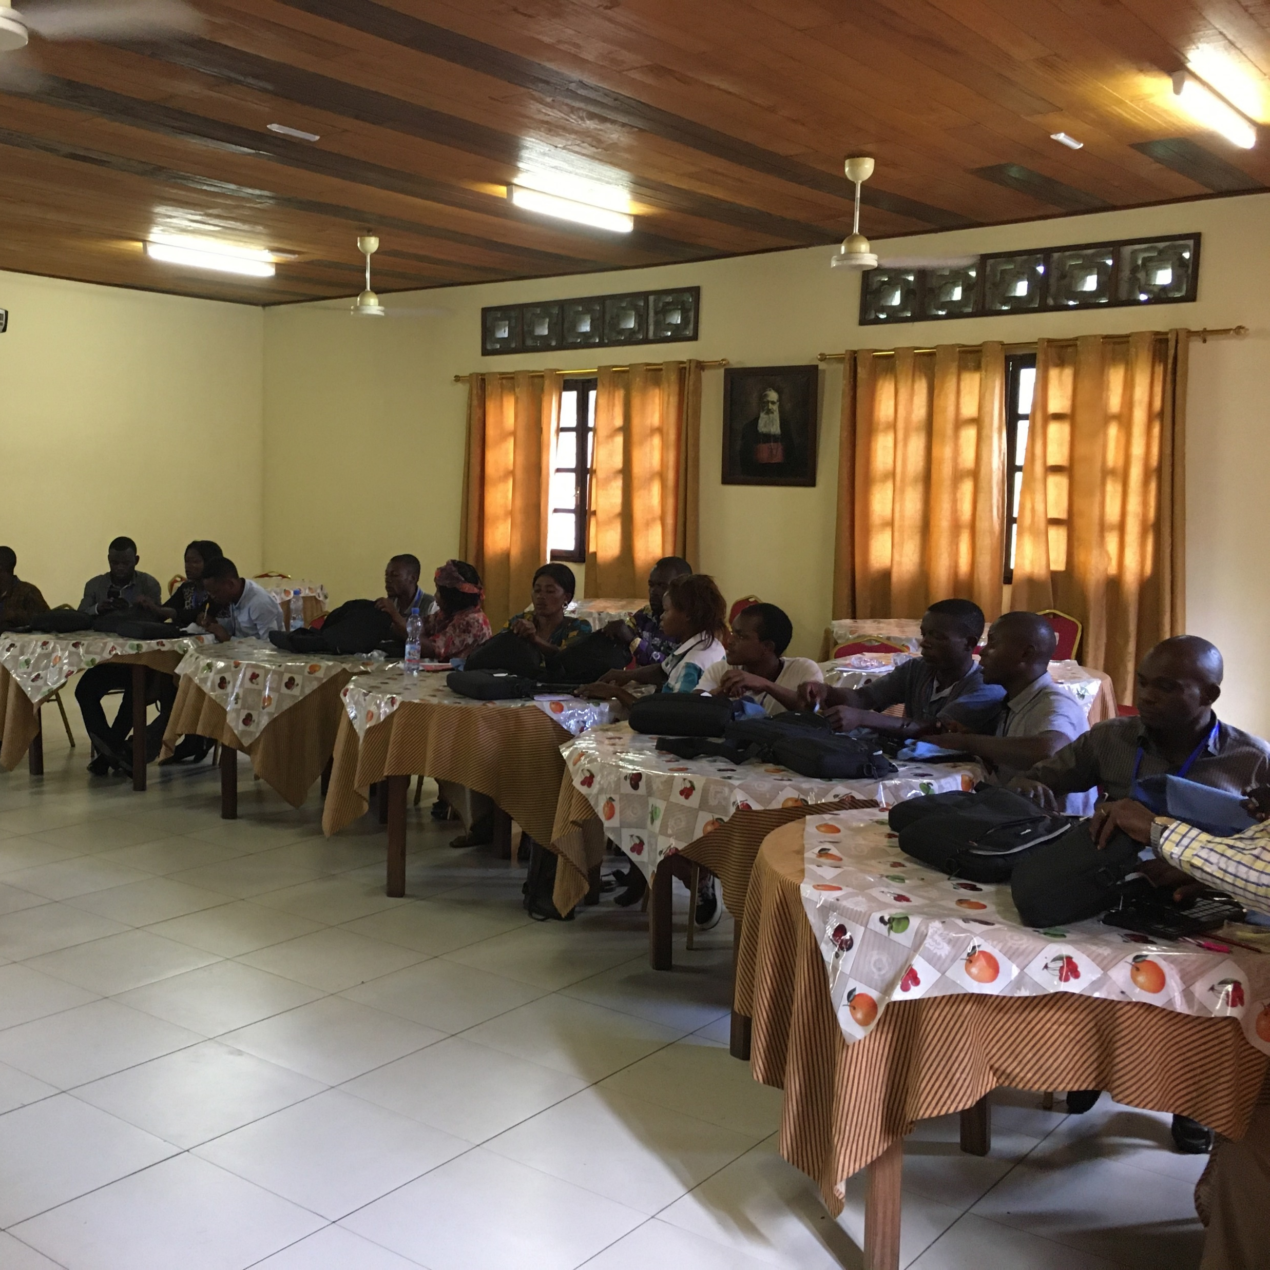
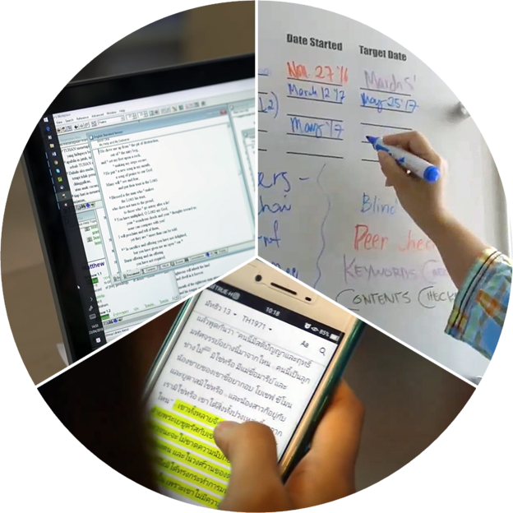
Location and Set-up
Practical workshop necessities
Consider the challenges of working from home

